Slide 1
HFM&LIP Recent Progress Report
March 12, 2020

Slide 2
Contents
Recent Progress
Status of Protection Work
Site Visit on March 8-9, 2020
Improvement of Construction Supervisory Work
Status of Consultancy Service

Slide 3
1.Recent Progress
1.1 Physical Achievement up to February 2020
1.2 Current Activities of Component 3-1
1.3 Current Concerns

Slide 4
1.1 Physical Achievement up to February 2020
Physical Progress = 63 %

Slide 5
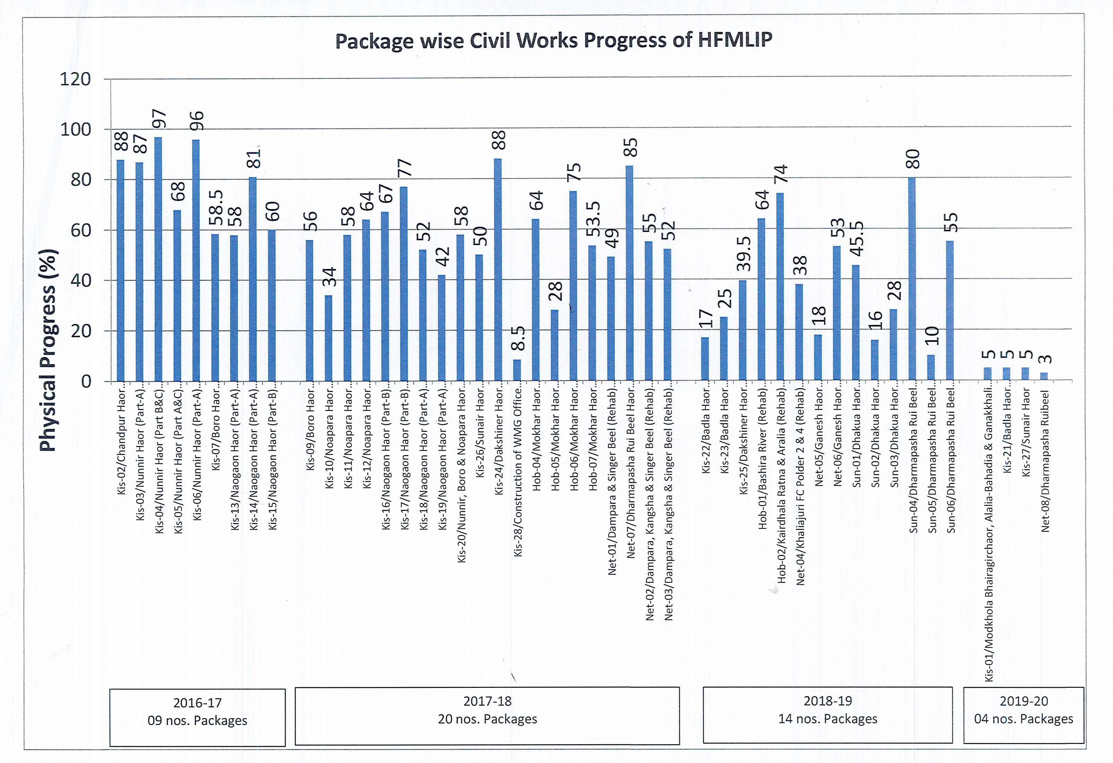

Slide 6
1.2 Current Status of Component 3-1
 | Scope | Major Activities | Target in DPP (2nd rev) | Achievement up to Feb 2020
A | WMO | - Committee Formation | 373 | 299
B | Local Training | - BWDB officials, Field staff, WMG members. | 11,700 WMG Members | 9,400 WMG Member
C | Agriculture Promotion Support Sub-Project (APSS) | - Farmer Training Program, - Demonstrations of crops, rice. - Farmer School Establishment | 69,983 Members | 42,482 Members
D | Small Scale Income Generation Sub-Project (SIGS) | - Homestead Vegetable - Cultivation and Support Service, etc | 26,867 Members | 15,264 Members
 |  | Total | 108,550 Members | 67,146 Members
Note: The International Expert, Mr Matsumoto will be mobilized later March.

Slide 7
1.3 Current Concerns
Slow Land Acquisition
Approval of the 2nd revised DPP including Protection Work
Approval of Consultancy Service Variation 1

Slide 8
2. Status of Protection Work
2.1 Procurement Status
GoB approval is expected to be granted in April,2020.
Tender announcement at the end of April.
Contractor will be chosen by the end of June.
→ The work will be undertaken in the next dry season.

Slide 9
2. Status of Protection Work
2.2 Repair Work
Repair work of the damaged submersible embankment is in progress for the up coming pre-monsoon season.
Type B5 protection will be applied at Ch 1.5 km, Dhamparasha Rui Beel for trial.
Type B5: Embankment body is covered by geotextile which is overlaid by turfing.

Slide 10
3. Site Visit on March 8-9, 2020
3.1 Itinerary, Participants
3.2 Findings
3.3 Follow Up

Slide 11
3.1 Itinerary, Participants
Participants:
Mr Maeda, JICA Advisor to BWDB Mr Fakhrul Abedin, Co-TL2, Consultant
Mr Saleheen, JICA Project Officer Dr Iryo, Soil Engineer, Consultant
Mr Shamsul Alam, PD, BWDB Other BWDB and Consultant Site Staff
Mr Md. Asaduzzaman, DPD, BWDB

Slide 12
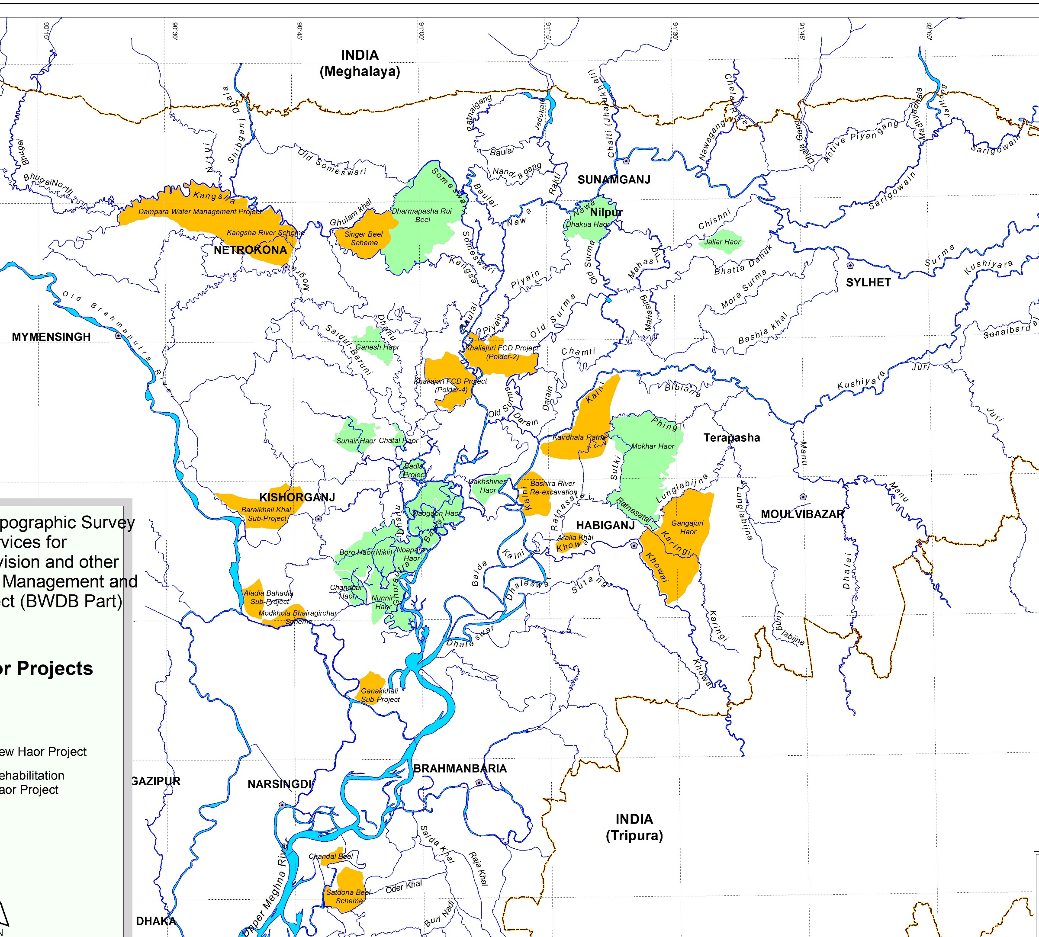
3.1 Itinerary
Dharmapasha Rui Beel
Ch0.5, 1.5 km
Sylhet

Slide 13
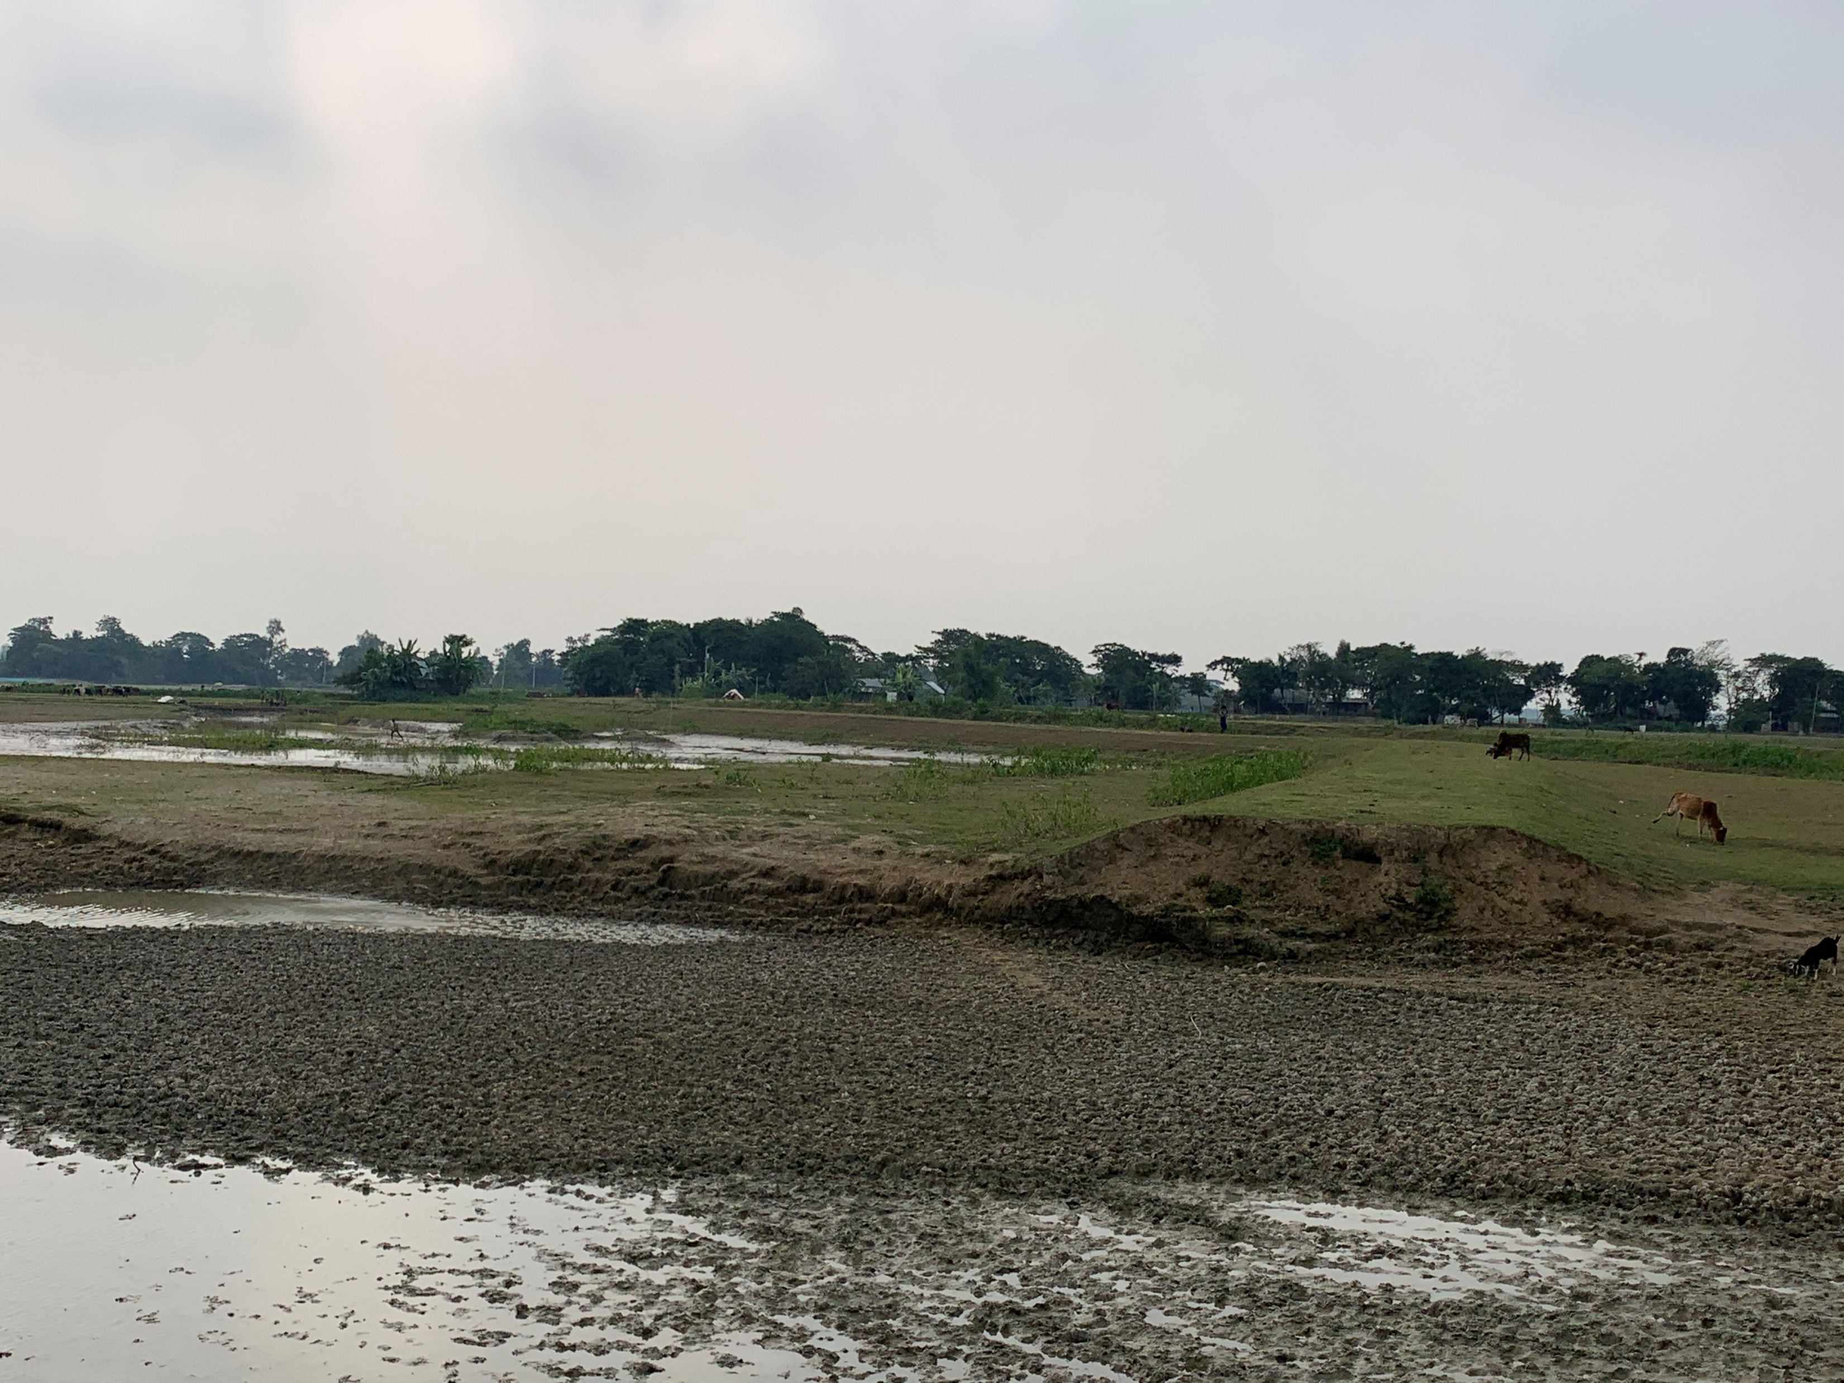
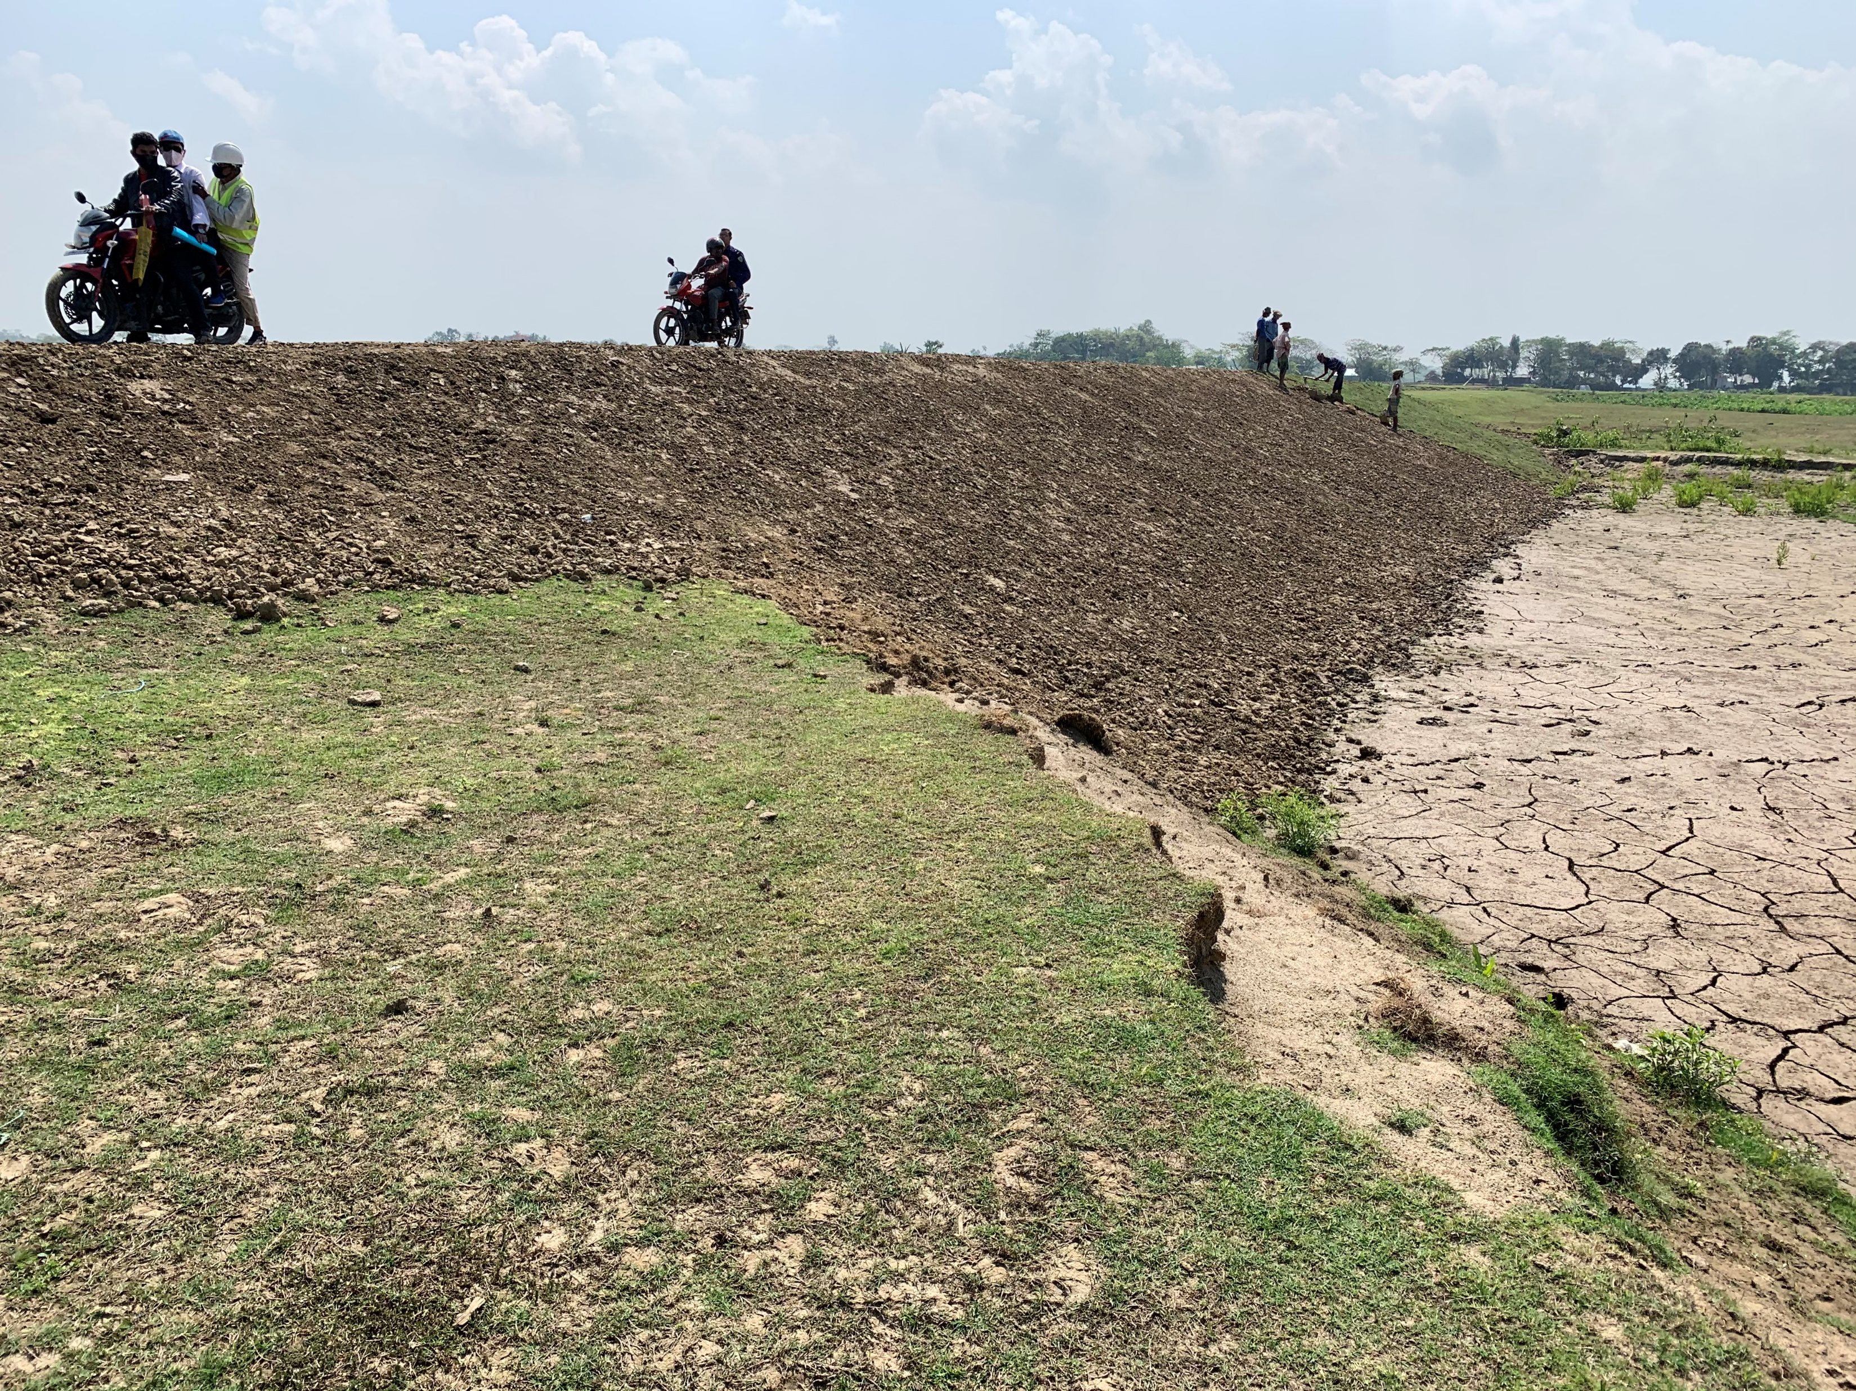
3.2 Findings (Ch 0.5km)
Dec 11, 2019
March 9, 2020

Slide 14
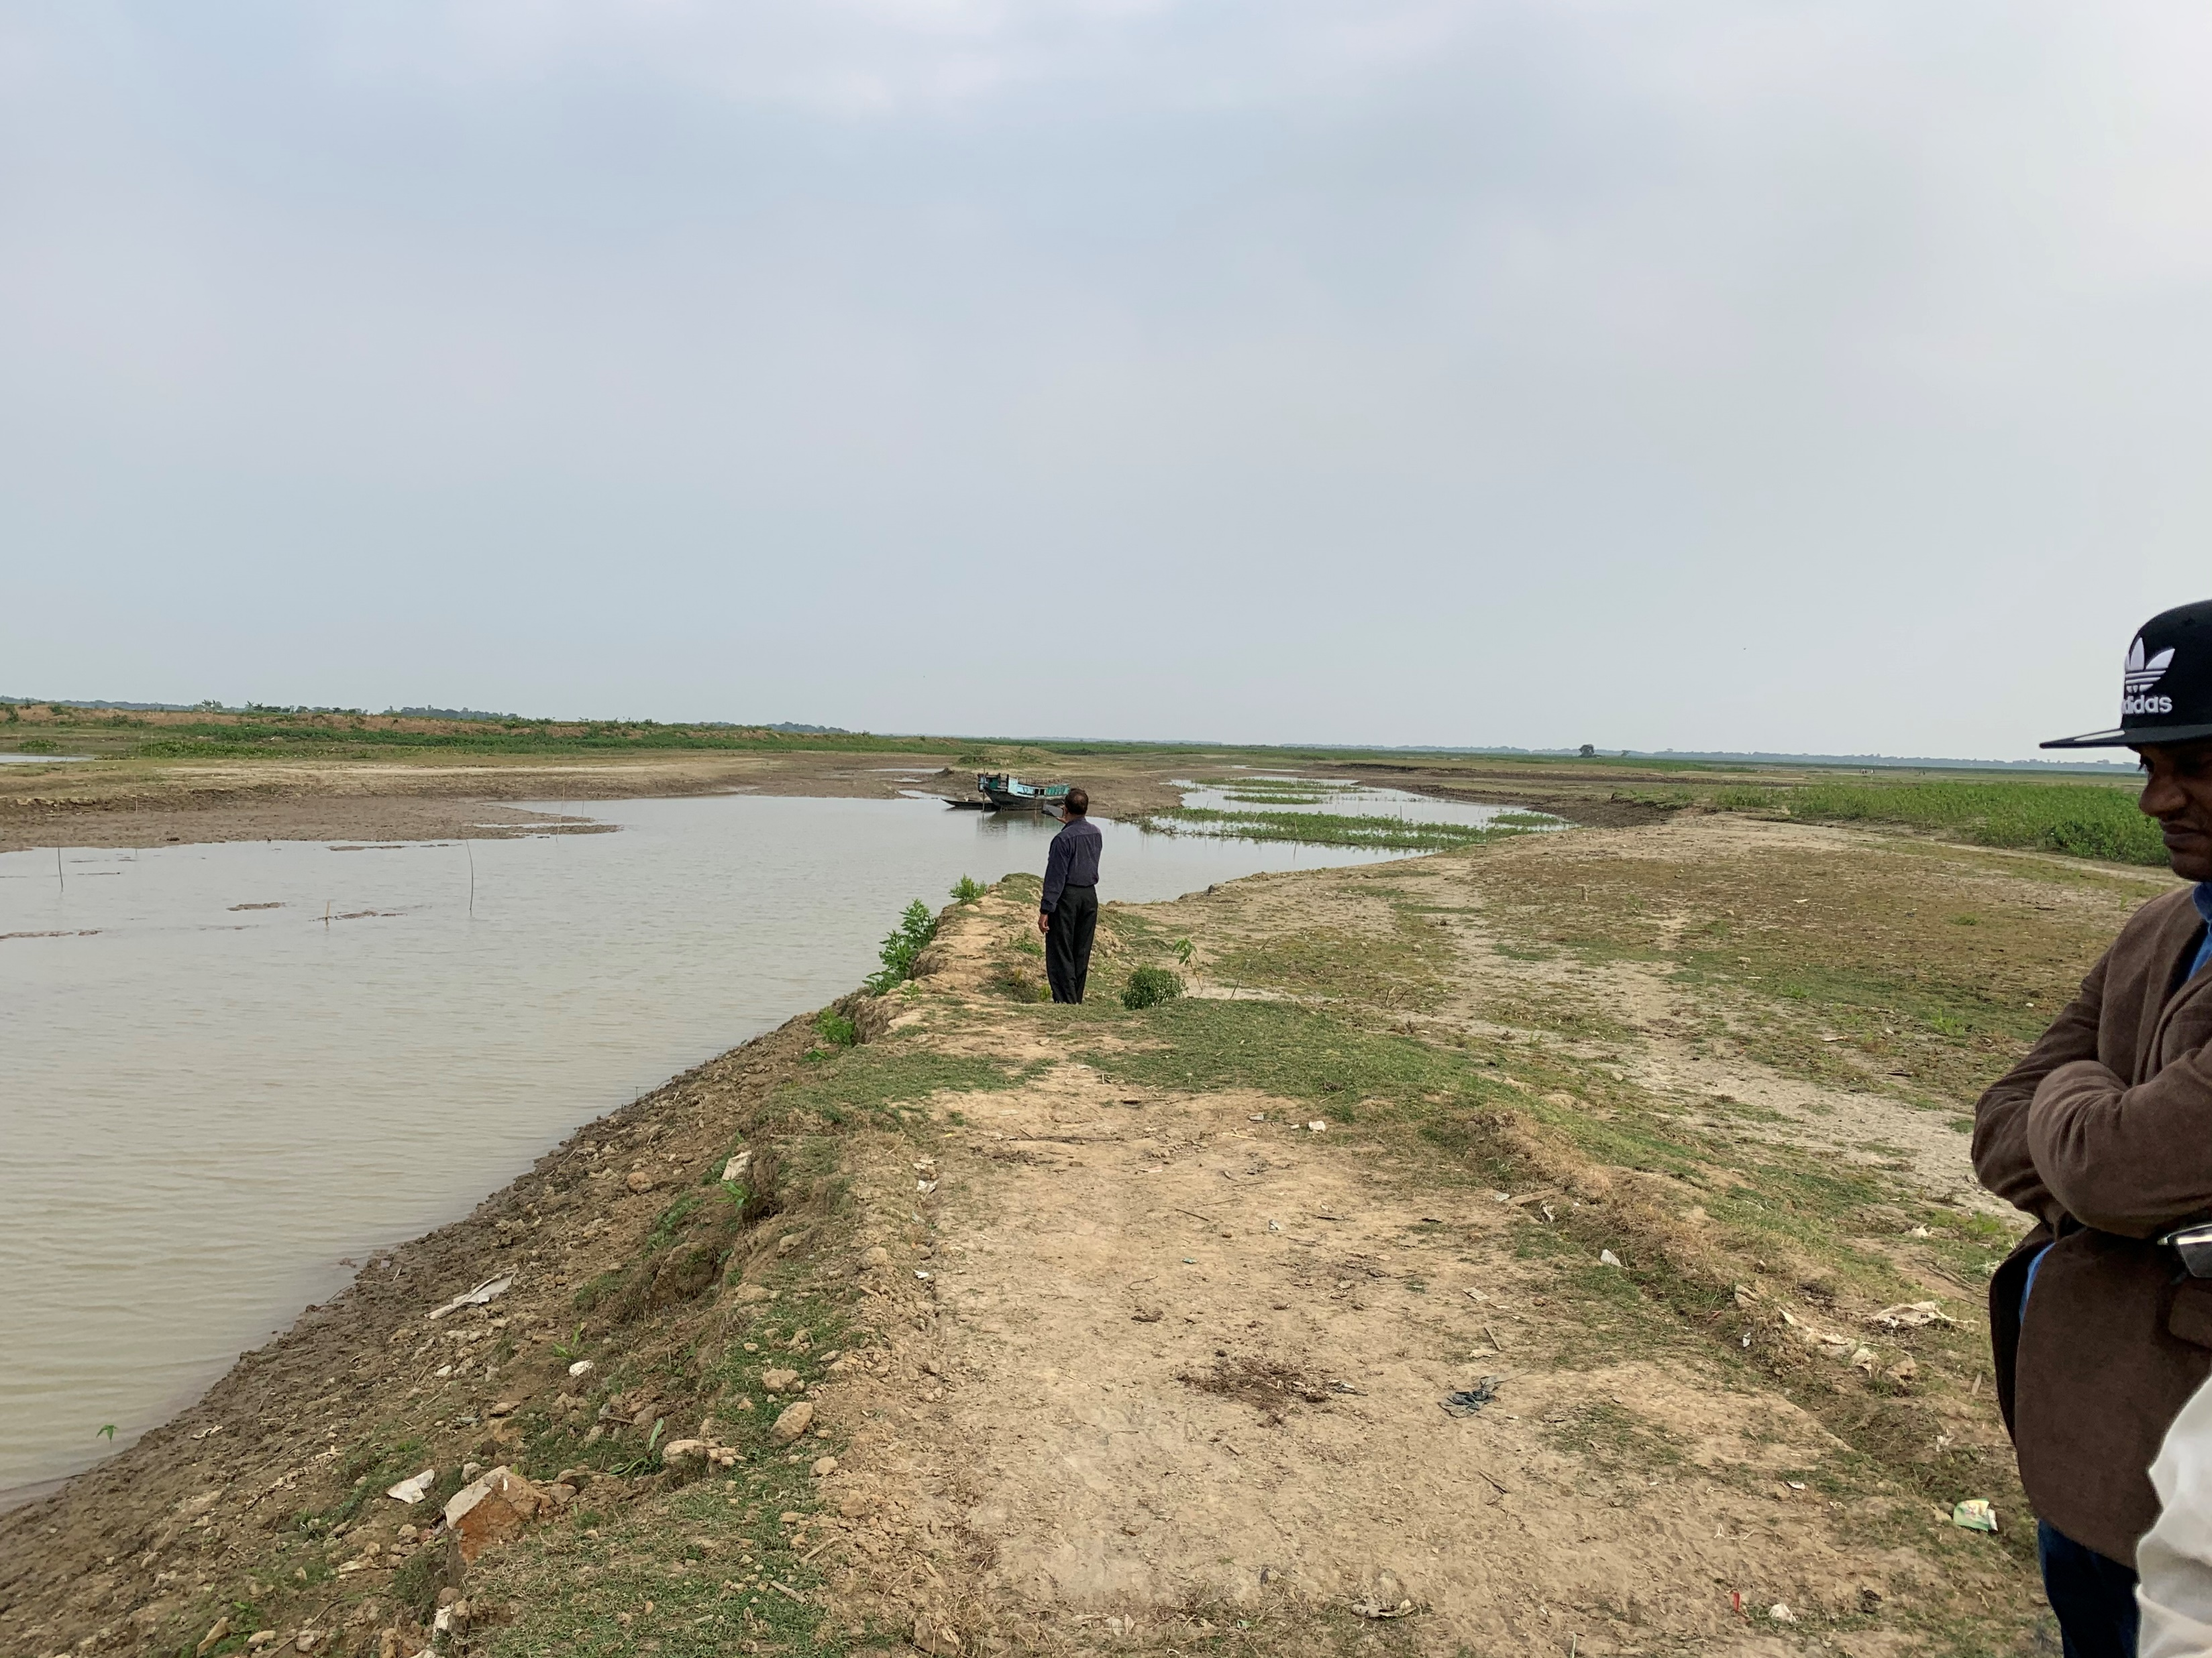
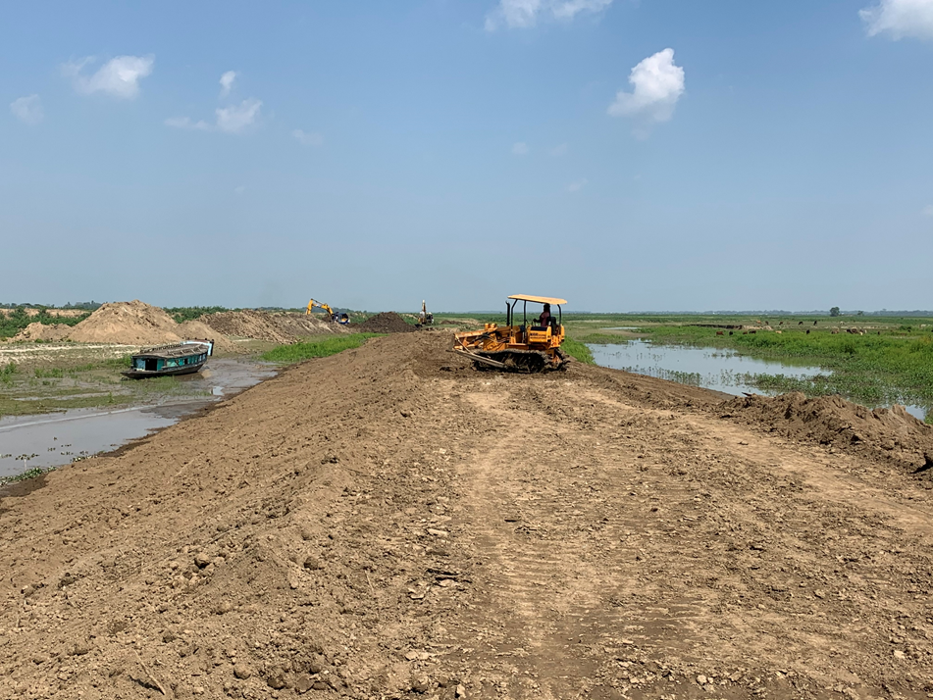
3.2 Findings (Ch1.5km)
Dec 11, 2019
March 9, 2020

Slide 15
3.2 Findings
Repair work of submersible embankments is underway both at Ch 0.5 km and 1.5 km for upcoming pre-monsoon season.
Geotextile is already on site for applying Type B5 at 1.5km.
Compaction was undertaken using chain dozer.
Several compaction tests are to be undertaken.

Slide 16
3.3 Follow Up
Mobilize roller compactor to carry out further compaction.
Compaction test to be carried out at 2 locations at each of Ch 0.5km and 1.5km, depth at 0.5m and 1.5 m, making trench.
Review and improve site inspection system/procedure -> next section.

Slide 17
4. Improvement of Construction Supervisory Work
Comments of the JICA Advisor in January 2020
“BWDB needs to monitor and confirm the condition of the embankments such as grain size distribution of material of the embankments, compaction of the embankments, how to plant grass on slope of the embankments, because these conditions can affect the function of them to prevent erosion”.

Slide 18
4. Improvement of Construction Supervisory Work
Grain Size Distribution
Sieve analysis to be carried out by BWDB technician on samples recovered from field compaction test and for modified proctor test.
Compile already available grading test results.
Planting Grass
Relevant specification of BWDB was sent to the contractors for reminder.
Site personnel shall keep monitoring.
Compaction
Remind site personnel to undertake compaction test even for repair work with proper machinery.

Slide 19
4. Improvement of Construction Supervisory Work
Chain of Command
Re-establish chain of command on site, focusing on Sr Construction Engineers
Close communication between Sr Engineers and Co-TLs.

Slide 20
5. Status of Consultancy Service
Variation 1 was approved by BWDB and submitted to the Ministry of Water Resource (MoWR) on January 13,2020.
Expected to get approval of GoB by April, 2020.
including approval of Co-TL2 and additional input of Soil Engineer and Safeguard (international experts).

Slide 21
Thank you

